Slide 1

ECFMG TPL VISAs Overview for New Admins
Lisa-Ann Roura, BS, C-TAGME
Ashley McDonald, BA, C-TAGME

Slide 2

Agenda
ECFMG
TPL
J1Visas
Q & A

Slide 3

Objectives
Gain valuable understanding of ECFMG and the visa process.
Be able to Navigate the ECFMG Visa Website
Learn steps for J1 Visa Process
Learn steps to become a TPL

Slide 4
ECFMG
Supporting J1s

Slide 5

Established in 1956, ECFMG is a world leader in promoting quality health care—serving physicians, members of the medical education and regulatory communities, health care consumers, and those researching issues in medical education and health workforce planning.
We offer a verification service that allows GME programs, state medical boards, hospitals, and credentialing agencies in the United States to obtain primary-source confirmation that their IMG applicants are certified by ECFMG.

Slide 6
ECFMG Programs
ECFMG Certification
Certification Verification Service (CVS)
ERAS Support Services at ECFMG
Exchange Visitor Sponsorship Program (J-1 Visa)
Electronic Portfolio of International Credentials (EPICSM)
Provision of USMLE Performance Data to International Medical Schools
Notes:
ECFMG’s program of certification assesses whether international medical graduates are ready to enter U.S. graduate medical education programs that are accredited by the Accreditation Council for Graduate Medical Education (ACGME). ACGME requires international medical graduates who enter ACGME-accredited programs to be certified by ECFMG. ECFMG Certification assures directors of accredited residency and fellowship programs, and the people of the United States, that international medical graduates have met minimum standards of eligibility.
ECFMG’s Certification Verification Service provides prompt, primary-source verification of an international medical graduate’s ECFMG Certification status. ECFMG’s CVS provides this verification to entities in the United States that rely on ECFMG Certification to evaluate the qualifications of international physicians. These entities include credentialing agencies; accredited residency programs; state medical licensing boards; and other organizations, such as hospitals and HMOs.
The Electronic Residency Application Service (ERAS®), developed by the Association of American Medical Colleges (AAMC), allows web-based application to first- and second-year (PGY-1 and PGY-2) residency positions in accredited U.S. programs of graduate medical education. ECFMG has been designated by AAMC to assist international medical students and graduates with the ERAS process. In this role, ECFMG issues ERAS Tokens, which allow international medical students/graduates to complete their residency applications on the AAMC website. ECFMG also collects and transmits supporting documents and transmits reports of ECFMG Certification status.
ECFMG is authorized by the U.S. Department of State to sponsor foreign national physicians for the J-1 Exchange Visitor visa for the purpose of participating in U.S. programs of graduate medical education or training. ECFMG is responsible for ensuring that Exchange Visitors and their host institutions meet the federal requirements for participation in the Exchange Visitor Program. ECFMG’s Exchange Visitor Sponsorship Program provides instruction and guidance to teaching hospitals, medical specialty organizations, universities, and international physicians on the credential and immigration requirements for J-1 visa sponsorship.
EPIC is a service for physicians and the entities that register/license, employ, train, and educate them. EPIC allows physicians to build a web-based career portfolio of their primary-source verified medical credentials and to have reports on the authenticity of those credentials sent electronically to any organization, anywhere in the world. Medical regulatory authorities, hospitals, academic institutions, and other entities use EPIC to access verification reports on the credentials of their physician applicants
ECFMG provides eligible international medical schools with individual and aggregate data on the performance of their students and graduates who apply to ECFMG for USMLE Step 1 and USMLE Step 2 Clinical Knowledge (CK).

Slide 7
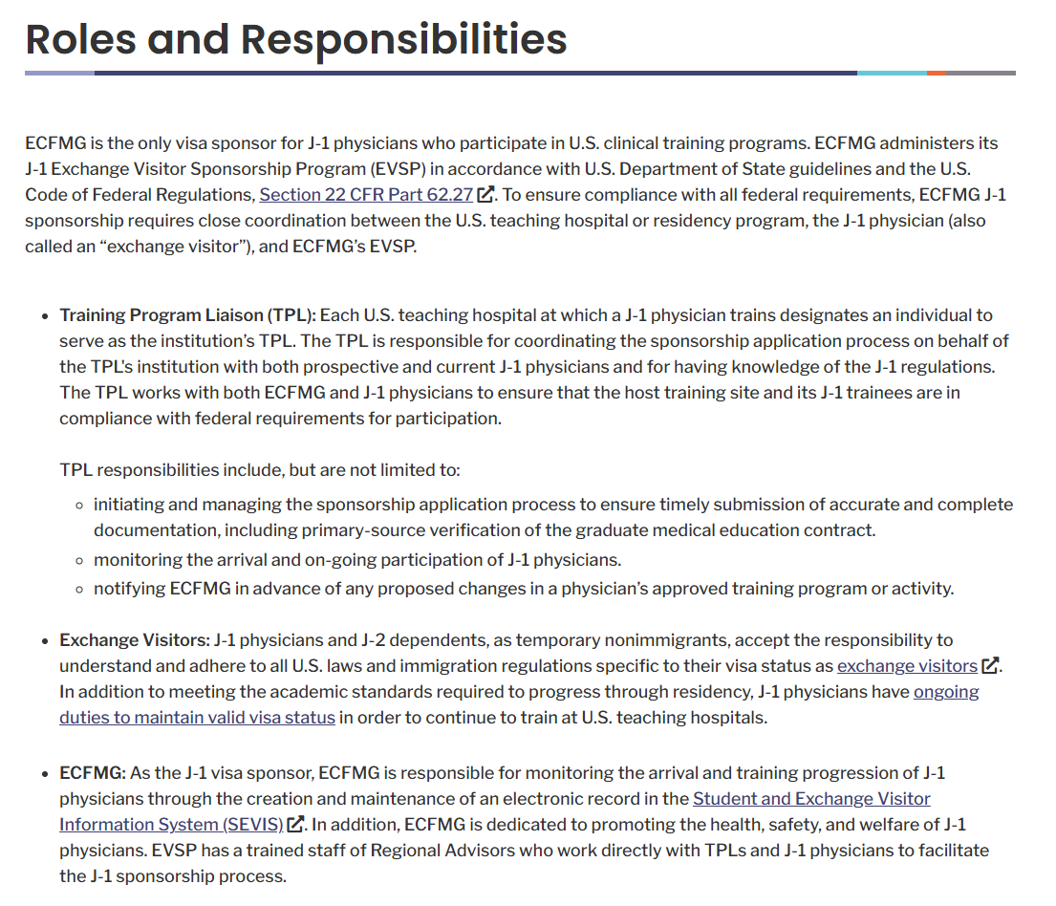
Roles & Responsibilities

Slide 8
Applicants
EVSP

Slide 9
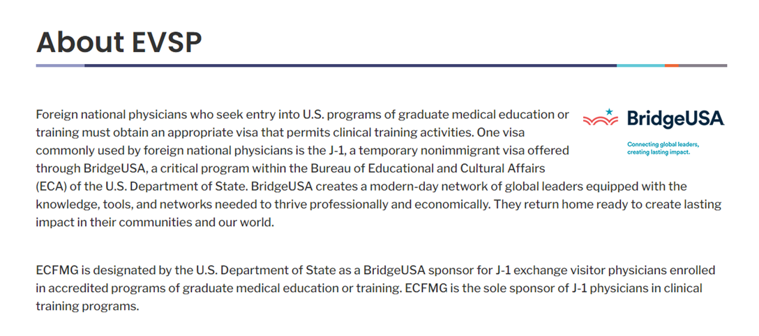
EVSP

Slide 10
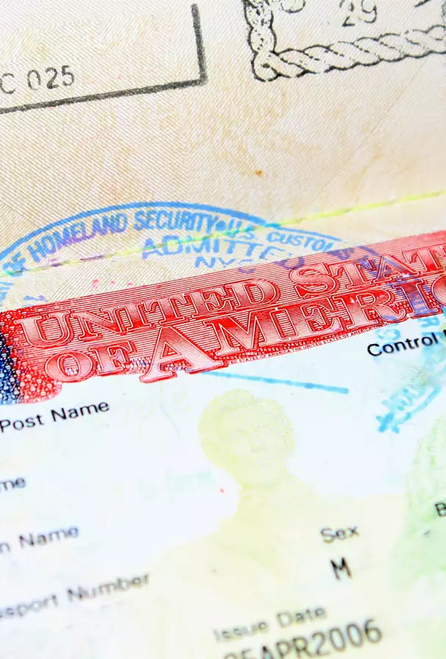
First things first – They’ve matched now what?
ECFMG
Intealth
EVSP
TPL
Contracts
Sponsor for Residents J1 Visa
Electronic System used for document upload by:
Program
Residents
Exchange Visitor Sponsorship Program
Training Program Liaison AKA
Coordinators/Administrators/Managers of Program

Slide 11
Important things
Requirements
Deadlines
Process Timeline
Travel Time
Understanding
Grace
Direct Residents to MyIntealth
  create a login that consists of a user ID (email address) and password, (watch a quick how-to video )
  complete and submit an account establishment request and pay the fee,
  complete their identify verification requirements
  receive a MyIntealth ID
Start as soon as they Match
  Need fully executed contract prior to starting the J1 Process
Notes:
MyIntealth is a new, integrated, online environment for accessing services offered by Intealth and its divisions. A MyIntealth account is required to request and use any of our services.

Slide 12
TPL

Slide 13
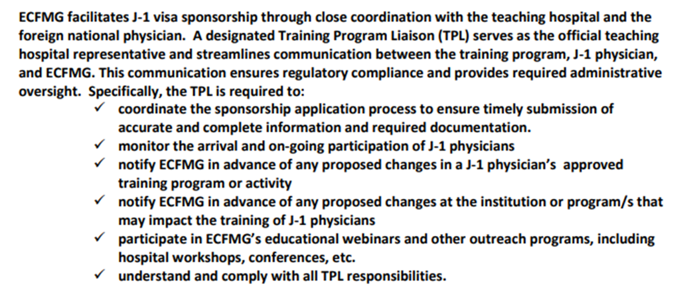
TPL Duties
TPL Application

Slide 14
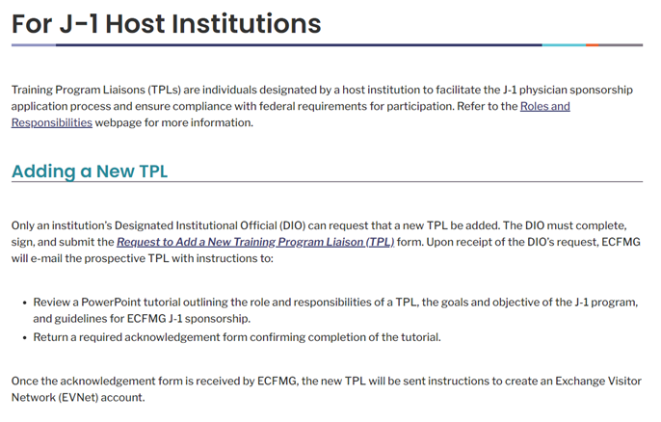
Pre-match day
Contracts
Work with your contracting department to make sure your contract is ready for Match Day!
ECFMG (Intealth)
TPL – Make sure you are set up as a TPL
Academic Year – Make sure to set up the new academic year

Slide 15

TPLs
Applicants
Accessing MyIntealth
Tips for Using MyIntealth
Training Program Liaisons (TPLs) Videos
J-1 Exchange Visitor Sponsorship Program Orientation Presentation for TPLs
How to Create Your Account
Identity Verification
MyIntealth Applicant User Guide
How to Navigate the Applicant Portal

Slide 16


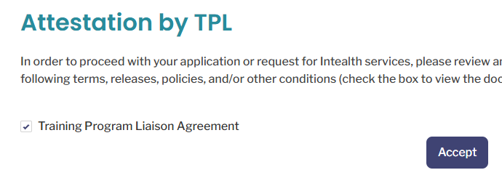
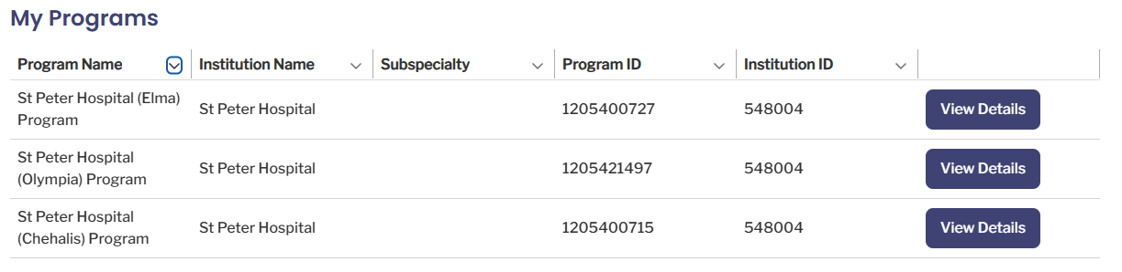
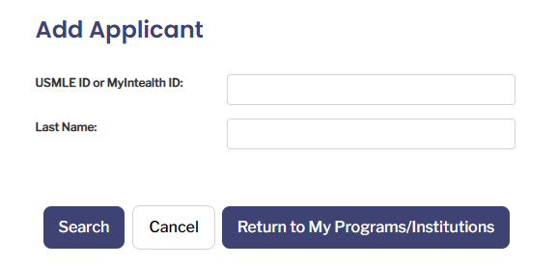
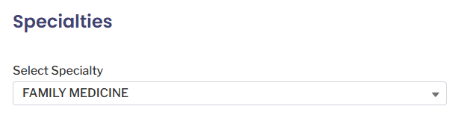
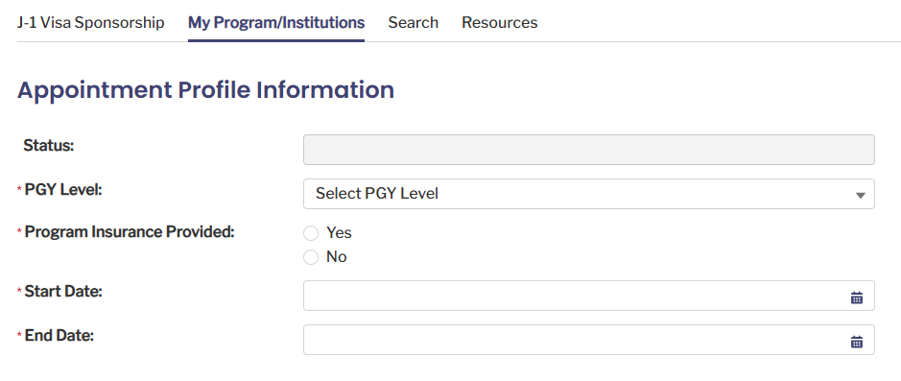
Adding Program and Academic Year
Select Specialty
Select Program
Add Applicant***
DS2019 Arrives
J-1 Visa Sponsorship
Notes:
***Can’t add Applicant until you have a fully executed contract. Contract must be wet signature unless the contract has an electronically verified signature (ie adobe, etc)
When adding in applicant you must attest that you have a fully executed contract.
Applicants must establish a MyIntealth account and have a MyIntealth ID before a TPL can initiate a sponsorship application through MyIntealth. TPLs are not permitted to request a MyIntealth ID on behalf of an applicant. Applicants and TPLs should contact EVSP with any questions.
Once DS-2019 Arrives
Scan into the resident file (or keep hard copy)
FedEx to resident
Resident is NOT allowed to come into US on a visitor’s visa and pick up the DS2019
If Resident is in US on training (ie education visa), can come and pick up

Slide 17
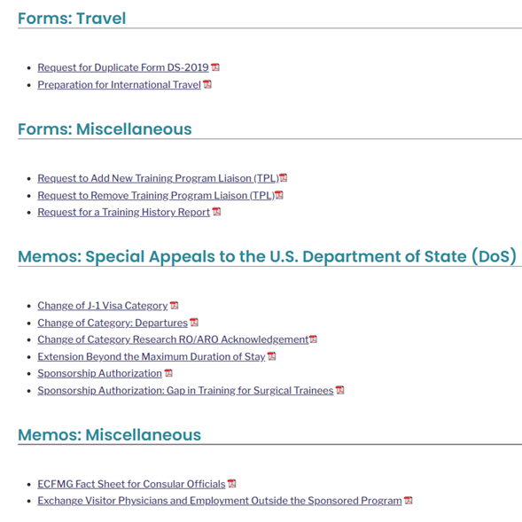
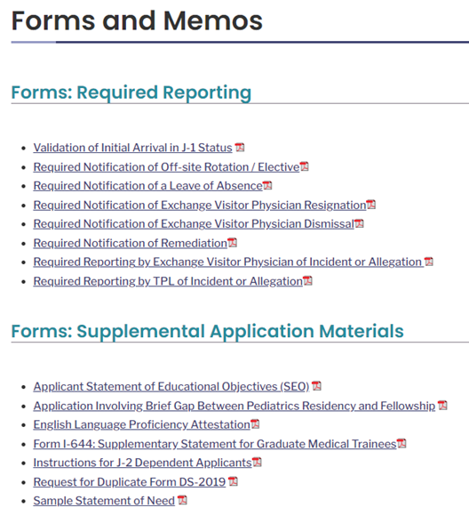
ECFMG Forms & Supplemental Application materials
**Validation of Initial Arrival must be completed when the resident arrives for the start of the program.
Residents are allowed in country up to 30 days prior to the start of training.
Residents MUST be in the US 10 prior to applying for a SSN.
Residents are NOT allowed to moonlight!
Notes:
Forms are now found in MyIntealth

Slide 18
FAQs
Statement of Need
Can the resident moonlight?
How long before they an apply for an SSN?
Are they allowed to travel out of the US?
Dependents AKA J-2
The holder of a J visa may enter the United States up to 30 days before the start of the program as indicated on the DS-2019.
J-1 physicians are authorized to engage in “supplemental clinical activities” within their training institutions, provided certain conditions are met. This added flexibility, sometimes referred to as “internal moonlighting,” can enrich the educational experience without extending training timelines.
Wait 10 days after arriving in the United States before applying for an SSN to allow enough time for resident’s arrival information to update in all government systems.
DS-2019 must have a valid travel signature.
A non-immigrant visa issued by a consular official at a U.S. embassy or consulate for spouses and dependents (unmarried children under the age of 21) of J-1 exchange visitors who accompany or later join the J-1 holder in the United States.
J-1 physician applicants may now submit a Statement of Need from either their country of citizenship or their last legal permanent residence, as outlined in federal regulation.
When can resident arrive in US?
Notes:
Internal Moonlighting:
Key requirements include:
Activities must take place within the same institution or primary clinical site as the physician’s accredited or non-standard training program.
Activities must be educationally appropriate and not extend the training period.
Prior written approval from both the program director and Intealth’s Responsible Officer is required; completion and submission of a new request form (available on the Forms and Memos page of the ECFMG website) constitutes this approval. Programs, not individual J-1 physicians, must initiate these requests.
All activities must comply with institutional policies, ACGME duty hour limits, and the physician’s core training responsibilities.
Statement of Need: Historically, applicants were often expected to obtain the SON from their country of last permanent residence if different from their citizenship. Going forward, applicants sponsored by Intealth may select the country most aligned with their intended return after training. Once established, the SON country cannot be changed. Physicians already under Intealth sponsorship must continue with the SON country determined at initial entry.
Transitional Sponsorship Between Training Programs: Intealth has received authorization from the U.S. Department of State to sponsor J-1 physicians for a reasonable transitional period of up to thirty (30) days between the end of one program and the start of another. As a result, contract dates between programs are no longer required to be contiguous. This programmatic change is effective immediately.
This important allowance gives physicians the time they need between training programs to relocate, acclimate, and prepare for their next role, supporting their health, safety, and long-term success. Please note that this period counts toward the seven-year maximum duration of J-1 sponsorship in the physician category.

Slide 19
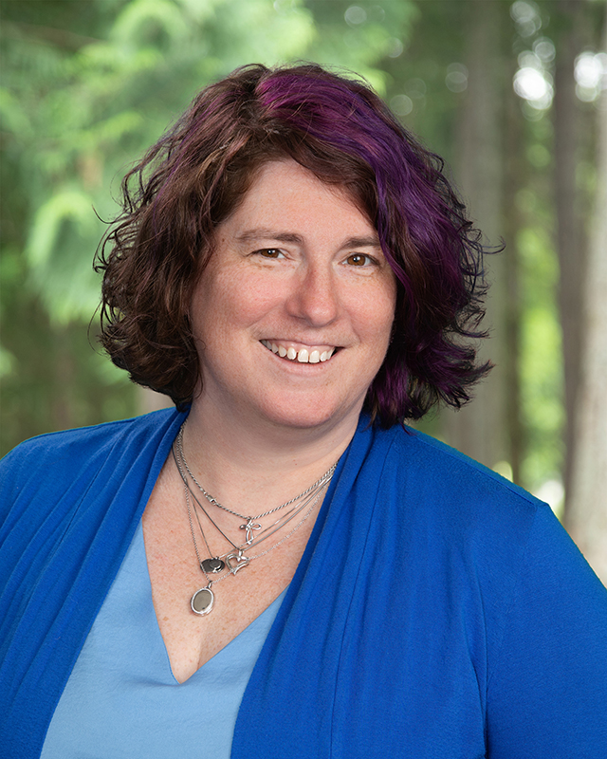

Thank you
Lisa-Ann Roura, BS, C-TAGME
Ashley McDonald, BA, C-TAGME
LisaAnn.Roura@providence.org
253.356.6085
amcdonald@indianarmc.org
304.816.6500

