Slide 1
Interview Process

Slide 2
How you get them is how you keep them
Translation: How we present and represent our organization will also be how we keep them as residents.
If you bought flowers for your girlfriend at every date, then it will be expected long-term and into marriage (aka residency).
Demonstrate you value them – give them the coordinator factor.
But identify those that are going to value you and the program.

Slide 3
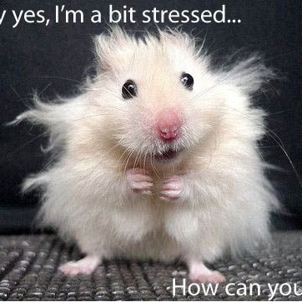
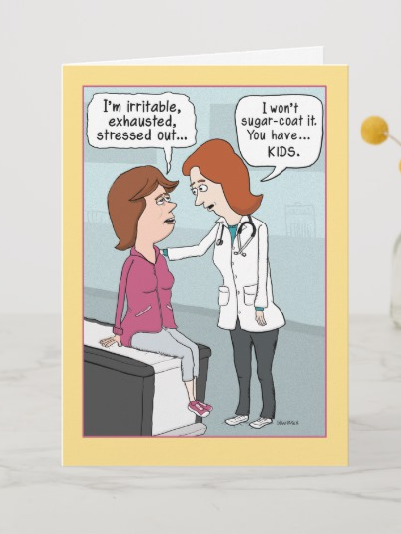
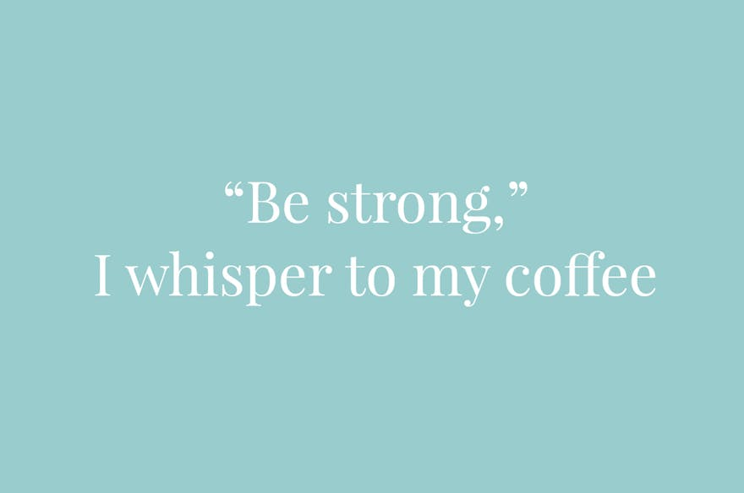
Dating should be a delight not a duty
Translation: Recruitment should be enjoyed, not just marking off check boxes.
Recruitment is tough but is an opportunity to show your passion in introducing candidates to your program.
Embrace the fact that someone crazy is going to show up, flex with the weather change for the community tour, and let your excitement show for the PD and faculty to help them relax. Breathe.

Slide 4
Quality Interactions

Slide 5
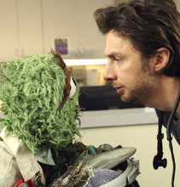
What they are they always will be
Translation: How they act at the interview is going to be how they act in the future.
The same can be said for coordinators, PD’s, and faculty.
If we are completely stressed or annoyed throughout the interviews, the candidates will believe that is how we always are.
Remember to take time to meditate, breathe, go for a walk – our wellness matters.

Slide 6
Be the right one and you’ll get the right one.
Translation: Keep strengthening the program and yourself to attract the right candidates.
We get feedback throughout the year to help us strengthen and improve various areas. Take the feedback to keep molding and refining areas.

Slide 7
Thank you!

Slide 8
Q & A

