Slide 1
Interview Season 2019: Lessons Learned
Jordan Norwood-Reynolds, MHA, Program Coordinator
Southern Hills Hospital Family Medicine Residency Program in the Sunrise Health GME Consortium
Deborah Egger, Program Coordinator
Mayo Clinic Family Medicine Residency – Eau Claire
Friday, February 8, 2019

Slide 2
Interview Season for Match 2019
Notes:
Congratulations! This was not easy and in case none of you have heard it, myself and Deb want to say Congrats and Thank you – your contributions are so needed ☺

Slide 3
Interview Season for Match 2019
Notes:
Icebreaker: One word descriptor for this most recent interview season. What is the first word that popped into your head?

Slide 4
Pre-interview Part 1
PD reviews applications via ERAS
Reviewer Score includes
Test Scores
Medical School and Gaps
Personal statements and LORs
Commitment to Family Medicine
West Coast Connection
Commitment to Underserved
Use ERAS RSVP functionality

Slide 5
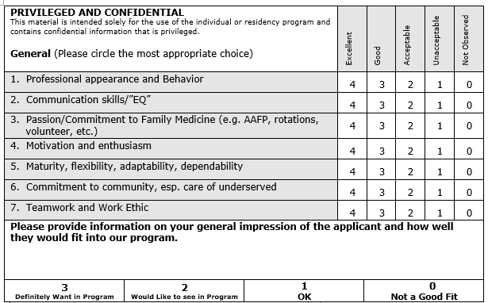
Interview Season Part 1
Interview 6-8 applicants per day/once a per week
October 15 – January 14
Residents host dinner night before interview and tours the day of
Interview day agenda
1:1 Program Director & Applicant
1:1 Program Faculty & Applicant
1:1 Current Resident & Applicant

Slide 6
Interview Season – Part 1
Each interviewer scores applicant’s based on variety of questions
During Interviewer Huddle, review scores, red flags and ensure true picture is painted of applicant
PC gathers all comments from tour, dinner and interviewers
Split Rank Meetings between Faculty/PD and residents/PC
Faculty can make full adjustments to list or DNR
Residents can move applicants along tiers or DNR
Consensus of final Rank Meeting findings is between PD and PC to certifying Rank Order List

Slide 7
Pre-interview Part 2
PD reviews applications via ERAS
Reviewer Score
Test Scores
Experiences
Letters of Recommendation
Commitment to Family Medicine
Personal Statement
Use ERAS to invite applicants for an interview & self-schedule

Slide 8
Interview Season Part 2
Interview 3 applicants per day/3 days per week October 11 – January 11
Resident(s) host dinner night before interview
Interview day agenda
1:1 Program Director & Applicant
1:1 Program Coordinator & Applicant
Interview Panel (panel = Faculty, RD, Nursing)
Each interview session scores the applicant on scale 1 - 5
Very strong evidence skill NOT present | Strong evidence skill NOT present | Some evidence skill IS present | Strong evidence skill IS present | Very strong evidence skill IS present | Not enough evidence for or against skill
1 | 2 | 3 | 4 | 5 | X
Comments:

Slide 9
Interview Season Continued Part 2
Each interviewer scores applicant’s Communication Skills plus BI question(s)
Review scores and interview scores are recorded on an Excel grid (Red flags, Gaps are noted on grid)
Applicants are categorized into groups. Group Number is defined by date of interview
Preliminary Rank Meetings are scheduled every 3 – 4 weeks to review applicants per group
Preliminary Rank Meetings consists of Faculty, PD, PC, and Rotation Directors
During preliminary rank meetings applicants are adjusted/DNR
Final Rank Meeting is Faculty, PD, PC and Residents
PD & PC review final list prior to certifying Rank Order List

Slide 10
Key Takeaways
Assessment of communication skills begin with initial communication/invite to interview
Seek resident feedback from dinners/tours & at final rank meeting
Seek feedback from leadership team that provide campus tours
Discuss box on interview evaluation sheet / Use of Interviewer Huddle

Slide 11
Review of Important Dates
AOA Rank Order List Certification Deadline was January 18
AOA Results of the Match were released February 4
NRMP Rank Order List Certification deadline is Feb 20 at 9 pm EST
March 11 Match Week Begins
10:30 am EST Medical school Unmatched Applicants report available
SOAP begins
March 14 SOAP ends @ 11 am EST
March 14 @ 2 pm EST Program Confidential Roster of Matched Applicants report is available
March 15 – MATCH Day!

Slide 12
Questions & Answers

