Slide 2
Onboarding, Credentialing & Orientation
A New Coordinator Workshop Follow-up Webinar

Slide 3
Onboarding
Tasks required in preparation for Residency/Orientation
Responsible parties – Incoming Resident, Program, GME
Residency Management Suite software like New Innovations or Med Hub can help automate your onboarding process

Slide 4
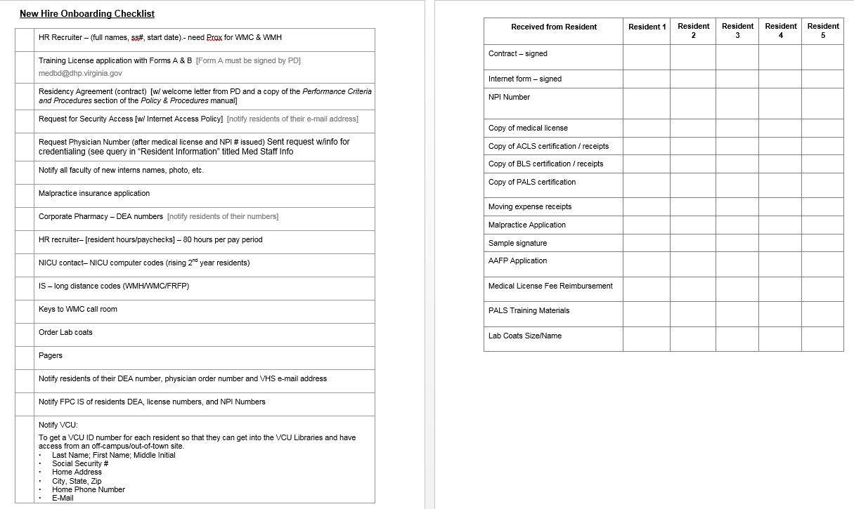
Sample Onboarding Checklists

Slide 5
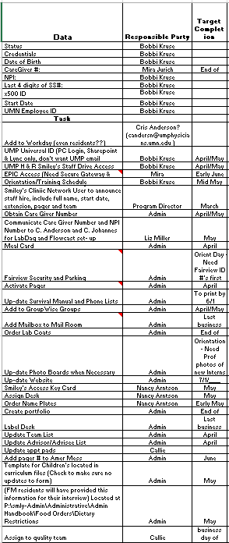
Sample Onboarding Checklists

Slide 6
Credentialing
NPI Registration https://nppes.cms.hhs.gov/NPPES/Welcome.do
State Medical Licenses, Residency License or Residency Permits
Locate state policy/requirements https://www.fsmb.org/policy/contacts
Drug Enforcement Agency http://www.deadiversion.usdoj.gov/drugreg/index.html#regapps
PECOS – Form CMS 855O https://www.cms.gov/Medicare/CMS-Forms/CMS-Forms/CMS-Forms-Items/CMS1249384.html

Slide 7
Orientation
GME Orientation
All programs of all specialties come together for basic GME requirements
Departmental Orientation
Multiple FM programs come together to address core FM topics
Program Orientation
Identify key activities and staffing needs
Some programs do pre-residency assessments during orientation
BLS/ACLS/PALS/ATLS Certification
Shadowing at core sites

Slide 8
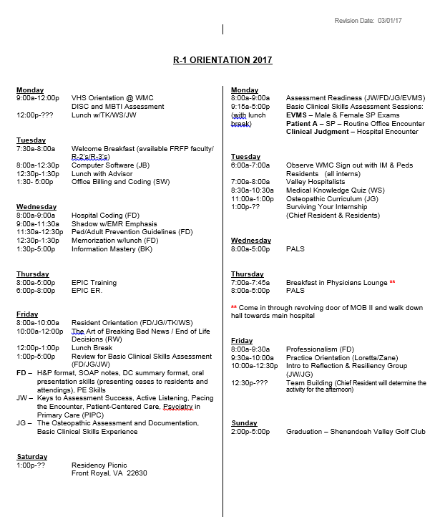
Sample Orientation Schedules

Slide 9
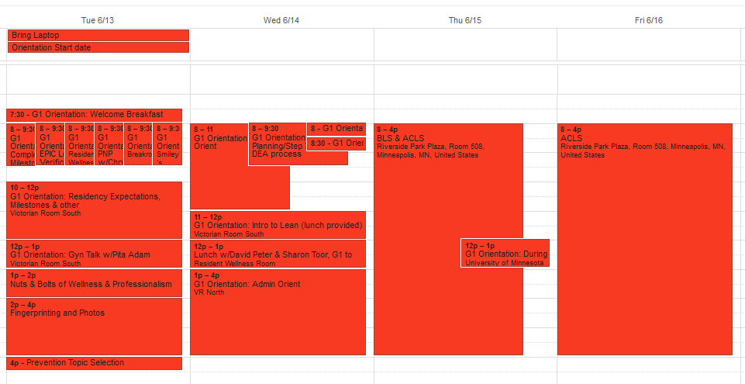
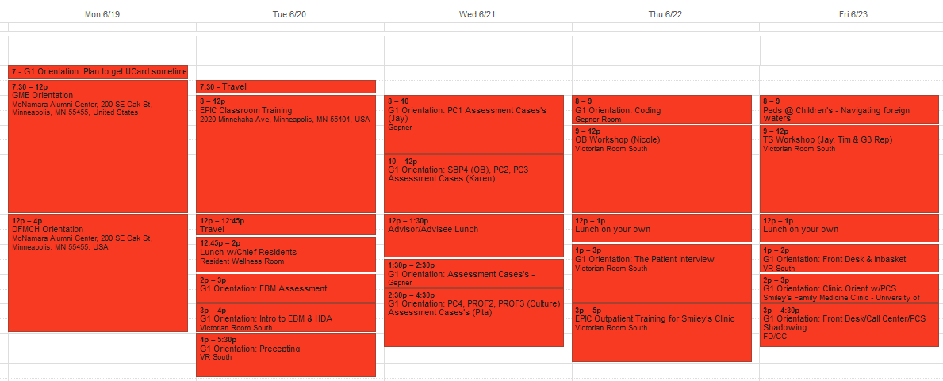
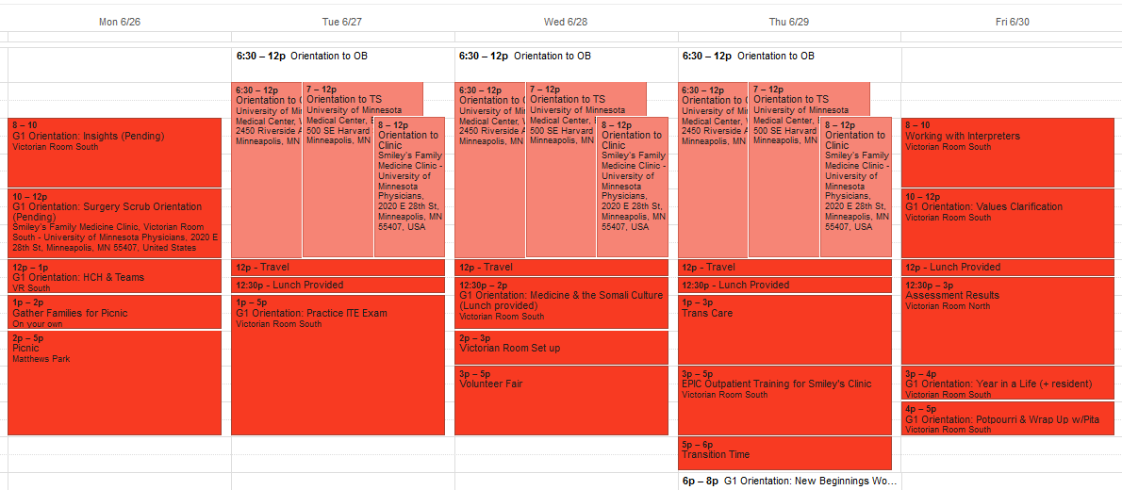
Sample Orientation Schedules

